Slide 1











We are
SCRIPTORIA
where ideas fuse and minds muse

Slide 2





































Allow your imagination to take place with our storytelling website specific for comic book enthusiasts, anime fans, and storytellers alike.
MERN
value

Slide 3



Slide 5


Slide 6





Problems
Communication Writing alone involves solitude, it lacks social engagement and collaboration which can make it difficult for authors to enhance their skills
Discoverability There are limited platforms available for creating a fanbase or enjoying one.
Publishing It is an important concern for writers to find a place to share their Writings, real-life publishing can cost you money.
Diversity and Cultural Barriers Neglecting diverse perspectives and limiting the audience base, this results in a narrow range of stories.

Slide 7





COMPETITIVE ADVANTAGE

Slide 8





DO YOU OFFER A REAL-TIME CHAT feature?
NO, YOU CAN CHAT WITH YOUR FRIENDS BUT YOU HAVE TO REFRESH THE PAGE EVERY TIME TO SEE UPDATES.

Slide 9







CAN I COLLABORATE WITH FELLOW WRITERS TO WRITE TOGETHER?
NO, WE DON’T OFFER THIS FEATURE
NEITHER DO WE
...

Slide 10






CAN I PUBLISH MY STORIES ON
your platform?
NO, WE ALLOW YOU TO ONLY READ THE STORIES WE OFFER
SAME HERE

Slide 11




TELL ME ABOUT YOUR WEBSITE’S
DIVERSITY IN STORY CONTENT
DIVERSITY... ?

Slide 12

It enables creators to work together on projects, co-create stories, and engage in collective storytelling experiences, fostering creativity, teamwork, and shared ownership of content.
Collaborative Storytelling
It offers a strong sense of community among creators and fans, enabling meaningful interactions and discussions. Users can connect, share, and engage in feedbacks.
SCRIPTORIA STANDS OUT FOR ITS EMPHASIS ON
Community Engagement
It focusses on a rich exchange of stories, perspectives, and artistic styles by enabling creators to share diverse stories and characters, which enriches the content available to readers.
Diversity and inclusivity
Discovery and Recognition
It leverages aspiring creators to be discovered, build a fanbase, and gain recognition. It facilitates exposure and opportunities for creators to showcase their talent and grow their audience.

Slide 14
Archive of our own
WATTBAD

Slide 15
1.98 Billion USD
12.15 Billion USD
27.8 Billion USD
1.30 Billion USD
10.32 Billion USD
18.8 Billion USD
Comics market
Manga market
Online Book services Market
Market size value
in 2023
Revenue forecast
in 2032
CAGR= 4.9%.
Market size value
in 2022
Revenue forecast
in 2032
CAGR= 17.7%.
Market size value
in 2020
Revenue forecast
in 2027
CAGR=5.8%.

Slide 16
React: A component based, JavaScript based, frontend framework used for building user interfaces, particularly applications where dynamic content updates are crucial. React allows developers to create reusable UI components, manage the state efficiently, and improve performance with its virtual DOM.
Express js: A lightweight and flexible web application framework for Node.js that provides a robust set of features to develop web and mobile applications. It facilitates the handling of HTTP requests, routing, and middleware, making it easier to build robust APIs and web servers.
MongoDB: is a document-oriented database that stores all of its data as Binary JSON (BSON) documents. This allows for flexible, hierarchical data structures, making it easy to evolve the data model. MongoDB is known for its scalability and performance, especially for applications with large volumes of data and high transaction loads.
Node js A JavaScript runtime environment built on Chrome's V8 engine that enables server-side scripting. Node.js is designed for building scalable network applications, capable of handling numerous simultaneous connections with high throughput. It uses an event-driven, non-blocking I/O model, making it ideal for real-time applications.
M
E
MERN
R
N
STACK

Slide 17


MONGODB
a document-oriented database that stores all of its data as Binary JSON (BSON) documents.
BSON allows you to serialize many forms of data.
Using BSON documents allows you to store unstructured, semi-structured, and structured data. Instead of a database schema, MongoDB uses a flexible approach, storing documents in collections.
MONGODB
a document-oriented database that stores all of its data as Binary JSON (BSON) documents.
BSON allows you to serialize many forms of data.
Using BSON documents allows you to store unstructured, semi-structured, and structured data. Instead of a database schema, MongoDB uses a flexible approach, storing documents in collections.
@reallygreatsite
Read More
Read More

Slide 18

MongoDB design offers a significant advantage in terms of scalability. It has two key features for scaling:
· Replica sets—groups of MongoDB
servers that hold identical data
· Sharding—different parts of your data
distributed across different servers
MongoDB allows you to create sharded clusters, so portions of your data are replicated across multiple servers. For example, if you have a large number of customer records, you can distribute them so that names from A-J and names from K-Z are in their own replica set. MongoDB can thus scale horizontally to optimize both read and write performance at scale.
MongoDB documents follow a hierarchical data model and keep most of the data in a single document, reducing the need for joins across multiple documents.
Joins are supported via the $lookup operation, but they are not optimized for performance. However, MongoDB offers an insertMany() API for rapidly inserting data, prioritizing write performance.
By storing data as JSON documents, MongoDB lets you build complicated applications with many distinct data types. For instance, you can create new fields by updating nested array fields. You can also use an aggregation pipeline—a MongoDB feature that lets you transform data by combining multiple operations into a single workflow.
SCALABILITY
PERFORMANCE

Slide 19
MongoDB uses authentication, access control, and encryption to ensure the security of their databases.
It uses TLS/SSL encryption to protect data in transit and at rest.
It also allows you to define different levels of user access.
Within MongoDB, you can control access on an operation, collection, or database level.
SECURITY
AND
ACCESS CONTROL
MongoDB uses indexing to improve query speeds and performance.
Indexes are database structures that link to frequently accessed data. The index helps find and retrieve data very quickly.
It uses hash indexes, B-tree indexes, and several others.
INDEXING SUPPORT

Slide 20

01
Plan
06
02
Review
Design
Sprint 5
Sprint 4
Sprint 3
Sprint 2
Sprint 1
SPRINTS
Deploy
Develop
March 4th
05
03
April 20th
April 4th
March 27th
March 10th
Test
04

Slide 21



We used Kanban methodology to manage our project
Our Trello
Notes:
done
extra work
meetings
work frame
links

Slide 22






Why AWS?
WHAT IS
AWS EC2?
WHAT IS AN INSTANCE?
HOW EC2 WORKS?
BENEFITS OF AMAZON EC2

Slide 23
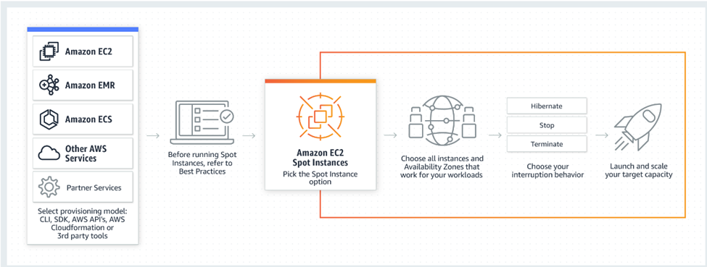
WHAT IS AWS EC2?
AWS EC2 (Elastic Cloud Compute) is a web service offered by Amazon that provides resizable compute capacity in the AWS cloud. It offers Infrastructure as a service (IaaS). It provides complete control of computing resources, which one can scale as per the requirement.
1. EC2 reduces the time required to boot and obtain new server instances.
2. It allows scaling capacity as per
the computing requirements.
3. Amazon EC2 provides system administrators and developers.

Slide 24
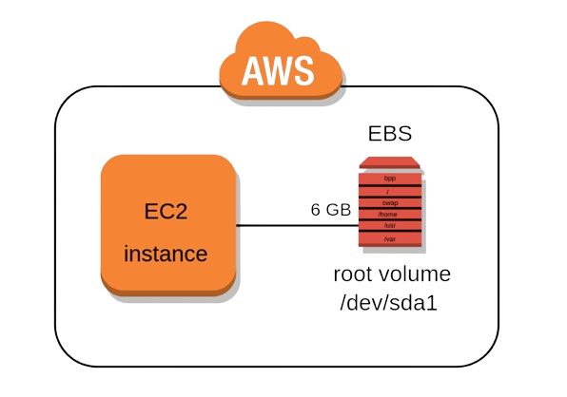
WHAT IS AN INSTANCE?
A virtual server used for running applications on Amazon’s EC2 is an instance. An instance can be understood as a small part of a large computer, having its own hard drive, network connection, OS, etc.
You can have multiple small computers on a single physical machine, and all these small machines are called Instances.

Slide 25
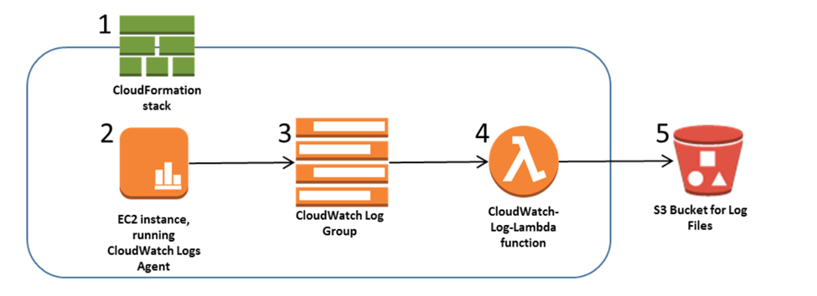
HOW EC2 WORKS?
You can have multiple small computers on a single physical machine, and all these small machines are called Instances.
During the setup, AMI(Amazon Machine Image) has to be created, which includes an operating system, apps, and configurations. After launching an instance, in the console, the user can either select an AMI template or create one. That AMI is loaded to the Amazon S3(Simple Storage Service), and it is registered with AWS EC2, creating an AMI identifier, at which point users can launch instances as per the requirement.

Slide 26
BENEFITS OF AMAZON EC2
COMPLETE COMPUTING SOLUTION
FLEXIBILITY
SECURITY
COMPLETELY CONTROLLED
EC2 provides you with choices of multiple instance types, software packages, instance storages, and operating systems. EC2 lets us configure memory, CPU and boot partition size which is optimal for the operating system and application.
Amazon works with Amazon VPC to provide robust networking and security for the compute resources. The compute instances are located in
a VPC (Virtual Private Cloud) in a specific IP range. This specific function helps the user in deciding which instances are exposed to the internet and which remains private.
EC2 works fine with Amazon RDS, S3, Dynamo DB and Amazon SQS. This provides complete computing, processing and storage solution.
One has complete control over the instances. Also, One can have root access to each instance and they can interact with them as any other machine. The user can stop instance while retaining the data on the boot partition and restart the same using web service APIs.
COST SAVING
EC2 is inexpensive as it allows the user to select plans as per the requirement. This will help the user to save cost and utilize the resources fully. EC2 passes the benefits of Amazon’s scale as the user has to pay a very low amount compared to the services they provide.
RELIABILITY
Amazon EC2 offers 99.9% availability for each Amazon EC2 region. The services are highly reliable where replacement of instances can be done easily and rapidly.
ELASTIC WEB-SCALE COMPUTING
Enterprises can easily increase or decrease capacity within minutes. They can commission thousands of server instances simultaneously. Additionally, all the server instances are handled by the web service APIs which can scale the servers up and down depending on the requirements.

Slide 27






Slide 28



Slide 29

Nellie
Laila
Johnny
Brady
Allie

Slide 30



Laila
Johnny
Allie
Brady
Nellie

Slide 31



Comic Collector “Laila”, 18 years old, a passionate comic book reader and collector.
Goals: Discover new comics, engage with community, participate in events, share favorites.
Preferences: Enjoys reading platforms, active in fan communities, attends comic conventions.
Needs Met by Scriptoria: Comic discoveries, community engagement, event participation, sharing favorite comics.

Slide 32


Writer “Johnny”, 32 years old, a writer exploring comic storytelling.
Goals: Develop writing skills, collaborate with artists, publish work, connect with readers. Preferences: Writing enthusiast, seeks collaboration opportunities, values reader interaction.
Needs Met by Scriptoria: Writing resources, artist collaboration tools, publishing platform, reader feedback.

Slide 33

Creator “Allie”, 27 years old, a freelance artist and writer.
Goals: Collaborate on projects, share work, receive feedback.
Preferences: Experienced in digital art, active in comic creator communities, values feedback and recognition.
Needs Met by Scriptoria: Collaboration tools, community feedback, monetization options, exposure to wider audience.

Slide 34
Diverse Style Sharer “Brady”, 21 years old, a writer with a unique sense of style.
Goals: Share unique styles, promote diversity, collaborate, connect. Preferences: Creates diverse content, engages in diversity discussions, share cross cultural stories.
Needs Met by Scriptoria: Platform for diverse content, community support, and cross-cultural exchange.

Slide 35

Aspiring Creator “Nellie, 20 years old, a writer exploring comic storytelling. Goals: Showcase talent, gain exposure, build fan base, seek a wide audience. Preferences: Active on social media, seeks mentorship, values feedback. Needs Met by Scriptoria: Exposure to wider audience, community engagement.

Slide 36




Special thanks to
Obada Khalili
Samer Huwari
Umar Abu Baker

Slide 37


We are
SCRIPTORIA

